Slide 1

Symfony 3
E. Stugys, Ž. Gasiūnas

Slide 2
what’s in store
why you should use a framework
mvc
symfony 3 introduction
demo
building your own page

Slide 3
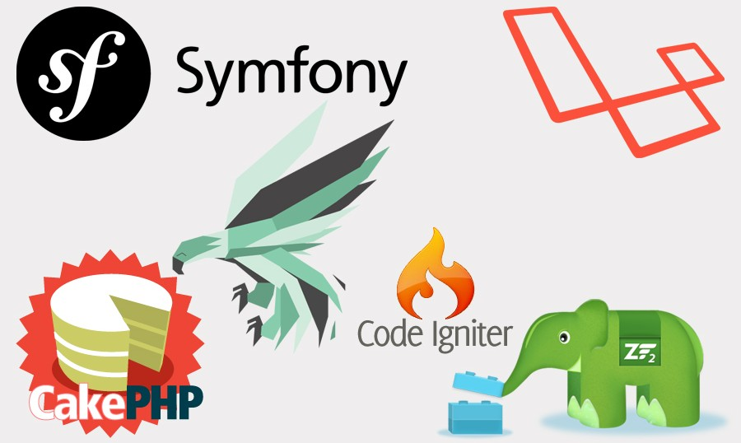
frameworks everywhere ...

Slide 4
coding without a framework
can lead to spaghetti code
leads to disorganization
difficult to re-use code
change one thing, break another
everything must be tested
hard code everything from scratch
teamwork challenges

Slide 5
why use framework?
recipe for clean code
reusable components
easy changes
organization
pre-built, pre-tested tools included
security and scalability

Slide 6
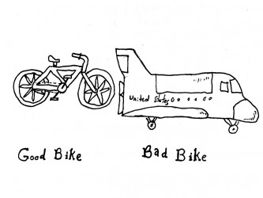
do we always have to use it?

Slide 7
so why use symfony ?
full-stack framework
flexible
stable
distributions-starter kits
components
LTS

Slide 8
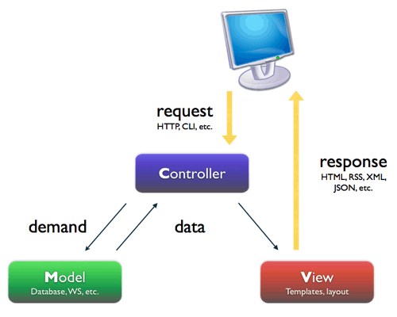
mvc

Slide 9
Q & A
ask before magic happens

Slide 10
Folder structure
app - application wide stuff and configs
bin - various scripts
src - sources for our projects
vendor - third-party dependencies
web - assets (like css, images, and so on)

Slide 11
creating bundle
cd to_project_dir
php bin/console generate:bundle

Slide 12
magic?
folder structure created
AppKernel.php
routing.yml

Slide 13
simple example
create controller
define route
create view using twig

Slide 14
more interaction
try $_GET parameter
change routing.yml
add parameter to controller
change template

Slide 15
whats next?
http://symfony.com/doc/current/cookbook

Slide 16
thanks
eligijus.stugys@nfq.lt, zilvinas.gasiunas@nfq.lt

Slide 17
advanced topics
dependency injection
factory
repositories
doctrine
observer
lazy loading

